Slide 1
Successful Self-Publishing
Seven Steps to
Tips to make a professional career out of self-publishing

Slide 2
Agenda
Be the 10%
Metadata
Formatting/Branding
Publishing
Series/rapid release
Paperback/Hardback
Audio
Mind your Business
Platform building
Marketing

Slide 3
Step 2: Assemble the Metadata
Notes:
Metadata is everything about your book that is not your book itself
Tagline, short blurb, long blurb, excerpt, chapter samples, ISBN, BISAC, BIC, THEMA, character interviews, key words, LOCCN, publication date, available date, onsale date, specifications, bios of all contributors, specifications, categories, marketing verbiage, books like, authors like, potential demographic
All of the things that vendors ask you are asked to build the metadata in their system
All of the things asked in the myidentifiers is to build the metadata for the print books
All of the things that an agent would ask for in a book proposal

Slide 4
Metadata
met·a·da·ta
ˈmedəˌdādə,ˈmedəˌdadə/
noun
noun: metadata; noun: meta-data
a set of data that describes and gives information about other data.

Slide 5
Metadata

Slide 6
Metadata

Slide 7
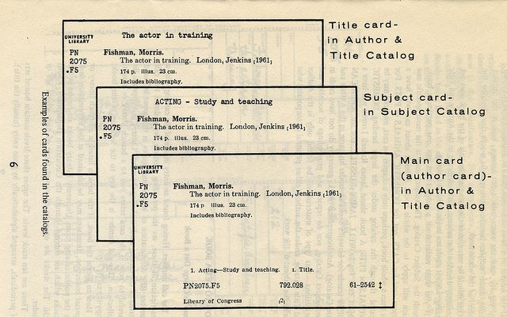
Metadata

Slide 8
Metadata
https://www.realtor.com/realestateandhomes-detail/4451-Shepherdsville-Rd_Elizabethtown_KY_42701_M46515-56507

Slide 9
Metadata

Slide 10
Metadata
Metadata is anything about the content of your book
Blurbs
Code inside the electronic version
Keywords
ISBN registration
Library of Congress registration
Categories/BISAC/BIC/THEMA/ONIX
Descriptions and mentions on the world wide web

Slide 11
Metadata
The Long Blurb
Dos
Reference the genre and central theme
Utilize key buzzwords
Create intrigue around the main conflict
Dive right in and introduce your protagonist
Keep it short and punchy
Reference your book-writing or professional status, if it relates to your book.
Notes:
Dos
-Reference the genre and central theme
-Create intrigue around the main conflict
-Dive right in and introduce your protagonist
-Keep it short and punchy
-Reference your book-writing or professional status, if it relates to your book.
Don’ts
-Give away any spoilers, no matter how tempted you are
-Give a summary of the first chapter
-Open with “In a world,” or any other overused phrase
-Give everything away
-Say how amazing your book is
-Compare yourself to other writers or your book to other books

Slide 12
Metadata
The Long Blurb
Don’ts
Give away any spoilers, no matter how tempted you are
Give a summary of the first chapter
Open with “In a world,” or any other overused phrase
Give everything away
Say how amazing your book is
Compare yourself to other writers or your book to other books
Notes:
Dos
-Reference the genre and central theme
-Create intrigue around the main conflict
-Dive right in and introduce your protagonist
-Keep it short and punchy
-Reference your book-writing or professional status, if it relates to your book.

Slide 13
Metadata
A Ruthless Serial Killer Seeks to End a Love Song Eight Years in the Making.
Assistant Commonwealth Attorney CAROL MABRY heads up an investigation into a string of stranglings in Virginia's capital. The serial killer known as Richmond Red remorselessly snuffs out beautiful young women with violin strings before ritually enshrining their lovely lifeless bodies inside a pentagram of blood red candles.
Country music superstar BOBBY KENT makes an unscheduled return trip to his Virginia home for the first time in years. To his shock, he discovers that he and Carol have a young daughter, Lisa. His parents have kept Lisa hidden from him her entire life while simultaneously deceiving Carol about Bobby's interest in fatherhood.
Angry and hurt over the deception, Carol and Bobby strive to cope with this newly discovered reality. They struggle to overcome harmful secrets and years of lies to decide whether they have a future. Neither of them realize how every waking moment they move closer to the serial killer who harbors an unnatural and deadly obsession.
With the beautiful Carol locked in Richmond Red's sights, the clock is ticking down to her destruction. Will the two find love, or is their sonata striking a dangerous final chord?
Notes:
Dos
-Reference the genre and central theme
-Create intrigue around the main conflict
-Dive right in and introduce your protagonist
-Keep it short and punchy
-Reference your book-writing or professional status, if it relates to your book.
Don’ts
-Give away any spoilers, no matter how tempted you are
-Give a summary of the first chapter
-Open with “In a world,” or any other overused phrase
-Give everything away
-Say how amazing your book is
-Compare yourself to other writers or your book to other books

Slide 14
Metadata
The Short Blurb
BOBBY Kent's name is synonymous with modern Country Music and he is no stranger to running from overzealous fans and paparazzo. But now he must protect his daughter and Carol, the mother of his only child, from a vicious and ruthless serial killer bent on their destruction.

Slide 15
Metadata
The Extremely Short Blurb
A Ruthless Serial Killer Seeks to End a Love Song Eight Years in the Making.

Slide 16
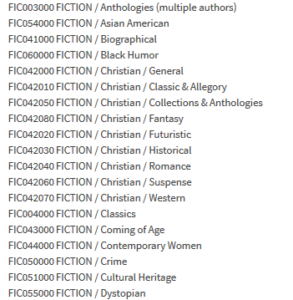
Metadata
Research/assign genre categories
BISAC
BIC/Thema (new international standard)
https://ns.editeur.org/thema/en/F
https://bisg.org/page/Fiction

Slide 17
Metadata
Create a text file of Keywords and Key-Phrases or the epub metadata
Everything you can think of about your book
No limit to how many keywords
Add how you spell your name and misspell your name
7 keywords up to 25 characters each
What will READERS search for?

Slide 18
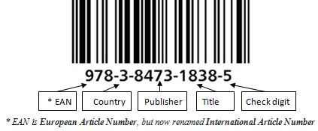
Metadata
Assign ISBNs
978-1-9396-0326-5
eBook
Print
Special versions (audio, large print, etc.)
Register with US Library of Congress (Optional)
Need to request to become a publisher with the Library of Congress
Set reminder to send paperback after release
Register with US Copyright Office (Optional)
Notes:
The GS1 Prefix is 978 or 979, when the EAN-13 symbol encodes a conversion of an International Standard Book Number (ISBN).^{[3]} Likewise the prefix is 979 for International Standard Music Number (ISMN) and 977 for International Standard Serial Number (ISSN).

Slide 19
Metadata
Assign ISBNs
978-1-9396-0326-5
eBook
Print
Special versions (audio, large print, etc.)
Register with US Library of Congress (Optional)
Need to request to become a publisher with the Library of Congress
Set reminder to send paperback after release
Register with US Copyright Office (Optional)
Registrations of a claim in a original work of authorship
Electronic filing:
Single author, same claimant, one work, not for hire $45
All other filings $65
Paper Filing (Forms PA, SR, TX, VA, SE) $125
Notes:
The GS1 Prefix is 978 or 979, when the EAN-13 symbol encodes a conversion of an International Standard Book Number (ISBN).^{[3]} Likewise the prefix is 979 for International Standard Music Number (ISMN) and 977 for International Standard Serial Number (ISSN).

